Slide 1
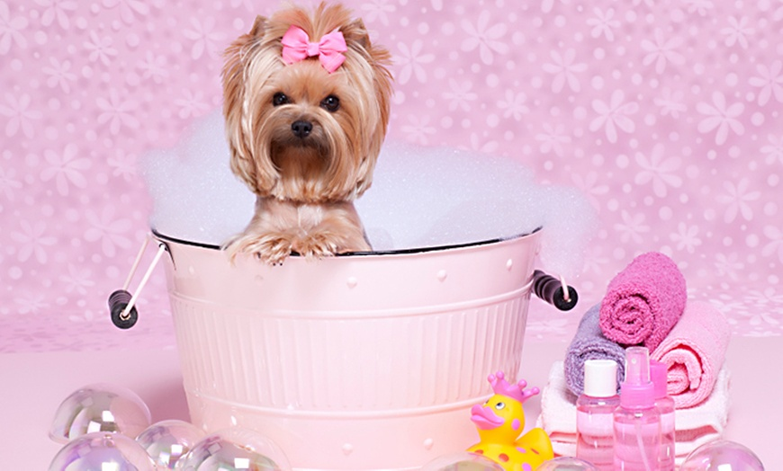

PA S
Grooming Spa

Slide 2
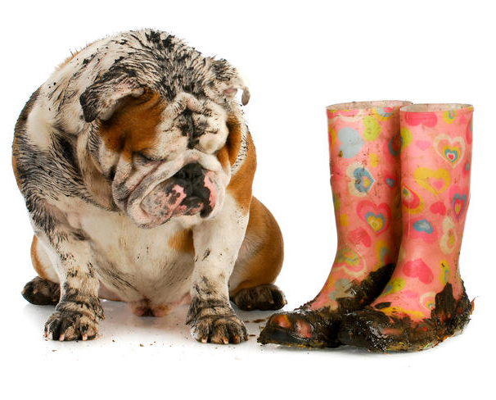
Problem Statement
Paws Grooming Spa clients are animal lovers and most of them are dog owners. They don’t like calling a location to make an appointment because they often have to wait on hold.
The issue aimed to be resolved is to create the ability for your customers to book grooming services online.

Slide 3
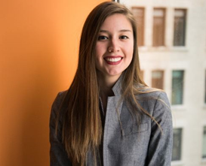
Persona — Silvia
Business Owner
Our team has composed a profile of key elements to take into consideration in order to create a solution to your problem we truly believe in. The objective to this presentation is to provide a solution for clients of Paws Grooming Spa with booking grooming appointments online.
By avoiding having to have long waiting times on the phone. In return, increase business with more appointments and allow for you to hire additional staff and provide quality support. Providing great quality services, we expect for 5-star reviews from your clients by providing solutions to your clients problems.

Slide 4
Profile
Challenges and Obstacles
Long wait hold time to schedule an appointment for costumers.
Get the right team that understands my needs for my new website.
Expand my business and understand the new needs.
Sales Objections
"We're already working with someone else".
"Just send me some information"
"I've never heard of your company"
"The price is too high"
Sources of Information:
Books — How to Raise the Perfect Dog
By: Cesar Millan,Melissa Jo Peltier.
Blogs — https://dogtime.com/
Conferences — https://aggressivedog.com/conference/
Experts — https://www.dogtopia.com/meet-the-experts/
Magazines — https://moderndogmagazine.com/
Websites — https://www.dogster.com/
Quotation
“A dog is the only thing on earth that loves you more than you love yourself.” – Josh Billings
Name
Silvia Specter
Age
32 years old
Gender
Female
Location
Kansas
Occupation
Owner Paws Grooming Spa
Highest Level of Education
Degree in Social Sciences
Annual Income
$47,000
Goals and Motivations
Open more locations with her grooming spa.
Improve the schedule system through the website.
Increase staffing at existing locations in order to extend appointment times.

Slide 5
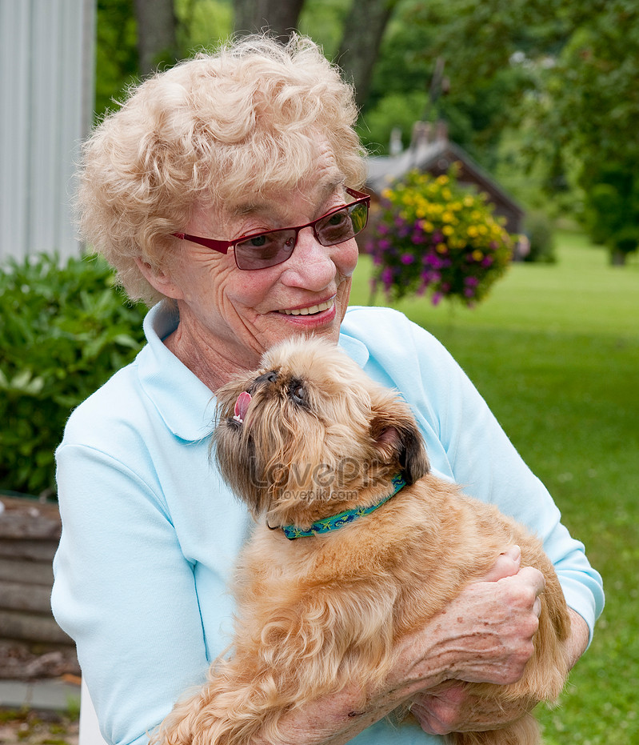
Persona — Suzie
Customer
Let’s go ahead take a look from a customer’s perspective of Paws Grooming Spa. Here we have Suzie who is an elderly lady who runs her own dog day care services and is looking to have her client’s dogs groomed by the time they are ready to be picked up by their owners.
In order for her to potentially grow her business, she needs a great, reliable dog grooming service with online booking services. This is where Paws Grooming Spa comes in to save the day and Suzie’s doggy day care business.

Slide 6
Profile
Challenges and Obstacles
Being on hold for too long while trying to book appointments for client’s dogs.
Inconsistent quality work from dog groomers. Expensive prices for dog grooming services.
Sales Objections
No online appointment booking.
Bad quality dog grooming services.
Inconsistent dog grooming services.
Bad 1st impression.
Sources of Information:
Books — Caring for your Dog, How to Train your Puppy
Blogs — Twinkl - How to Take Care of a Pet
Conferences — Pet Boarding and Daycare Expo
Experts — Cesar Milan
Magazines — Modern Dog, Dogmopolitan
Websites — petsmart.com, petco.com
Quotation
A mother’s love is a mother’s love and my dog is my life”
Name
Suzie
Age
67 years old
Gender
Female
Location
Kansas
Occupation
Owner Doggy Day Care
Highest Level of Education
Bachelor’s degree in Business Administration
Annual Income
$180,000
Goals and Motivations
To be able to book appointments for dog grooming services as quickly as possible.
Have clean dogs ready for when dog owners pick them up.
Increase clientele by providing consistent quality dog care services.
Open more locations in the future.

Slide 7
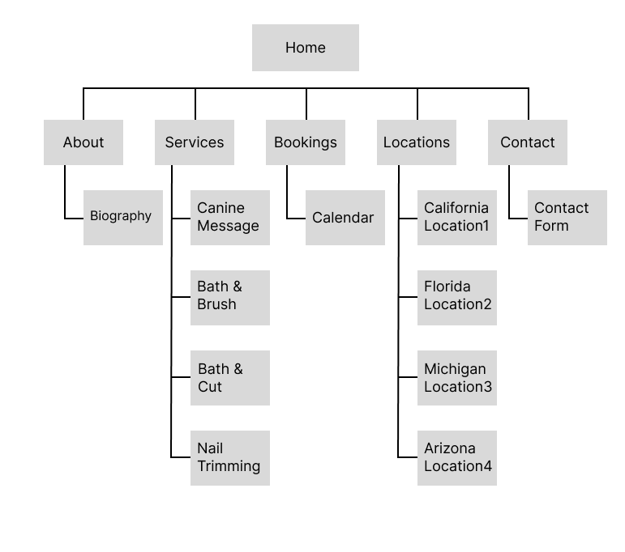
Sitemap

Slide 8
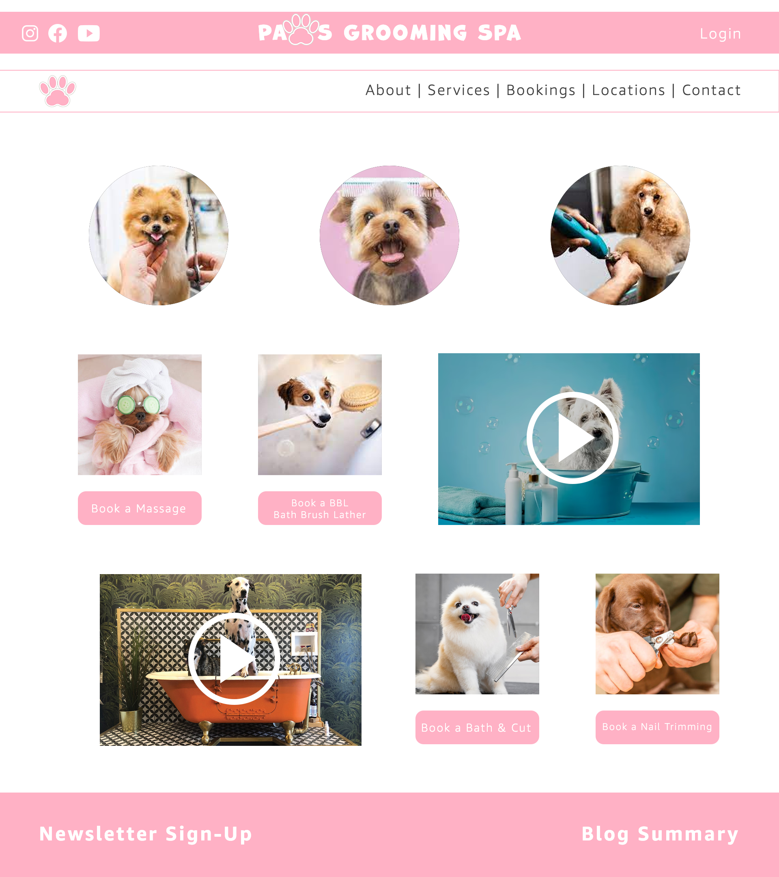
Mockup
In this mockup you will notice the focal point are the 3 circle graphics of some of the services Paws Grooming Spa has to offer.
You will also notice a top navigation bar on the right hand side. The difference from before and now is we have added the option for “Bookings” as well as all throughout the website’s main landing page and under every location’s page.
All a customer needs to do is click on any of the buttons added below each service or “Bookings” link on the top navigation bar. The customer will then be prompted to select their location, and enter their details. Both you and the customer will receive confirmation emails with the option to add it to their calendar of choice.

Slide 9
We thank you for the opportunity to obtain your business and we hope you choose our team to be part of Paws Grooming Spa’s success story!
THANK YOU!

